Slide 1






IB PYP
Transdisciplinary Themes
PYP Updates

Slide 2
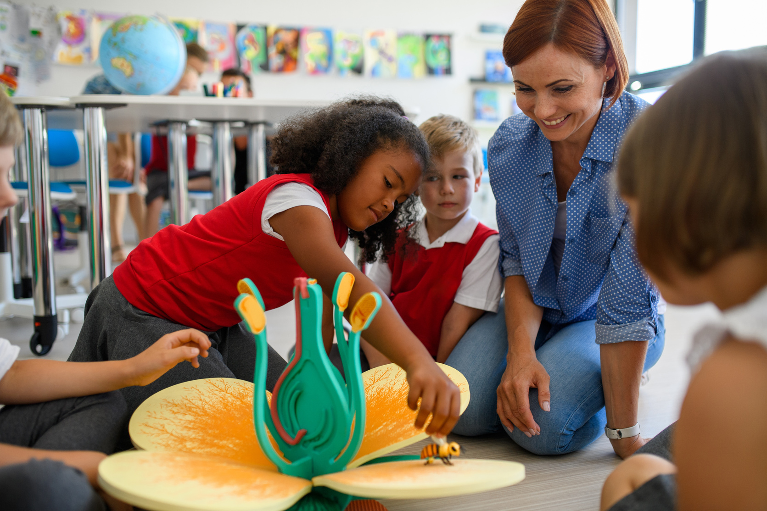


Who We Are
An inquiry into identity as individuals and as part of a collective through:
physical, emotional and spiritual health and well-being
relationships and belonging
Learning and growing

Slide 3
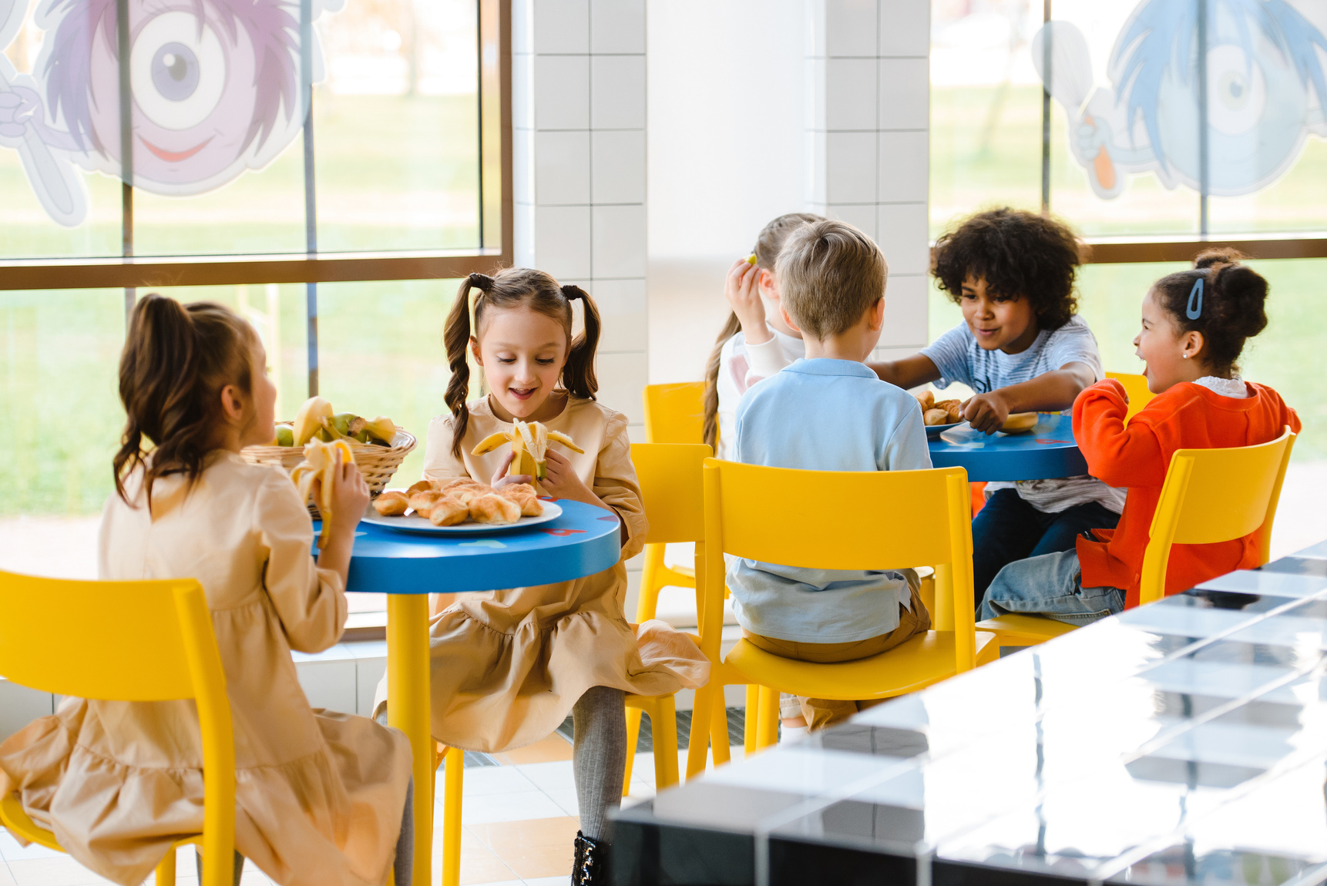
Where we are in place and time
An inquiry into histories and orientation in place, space and time through:
periods, events and artefacts
02
communities, heritage, culture and environment
natural and human drivers of movement, adaptation, and transformation

Slide 4

How We Express Ourselves
An inquiry into the diversity of voice, perspectives, and expression through:
inspiration, imagination, creativity
personal, social and cultural modes and practices of communication
intentions, perceptions, interpretations and responses

Slide 5
How The World Works
An inquiry into understandings of the world and phenomena through:
patterns, cycles, systems
diverse practices, methods and tools
discovery, design, innovation: possibilities and impacts

Slide 6

How we organise ourselves
An inquiry into systems, structures, and networks through:
interactions with and between social and ecological systems;
02
approaches to livelihoods and trade practice - intended and unintended consequences;
representation, collaboration, and decision-making

Slide 7
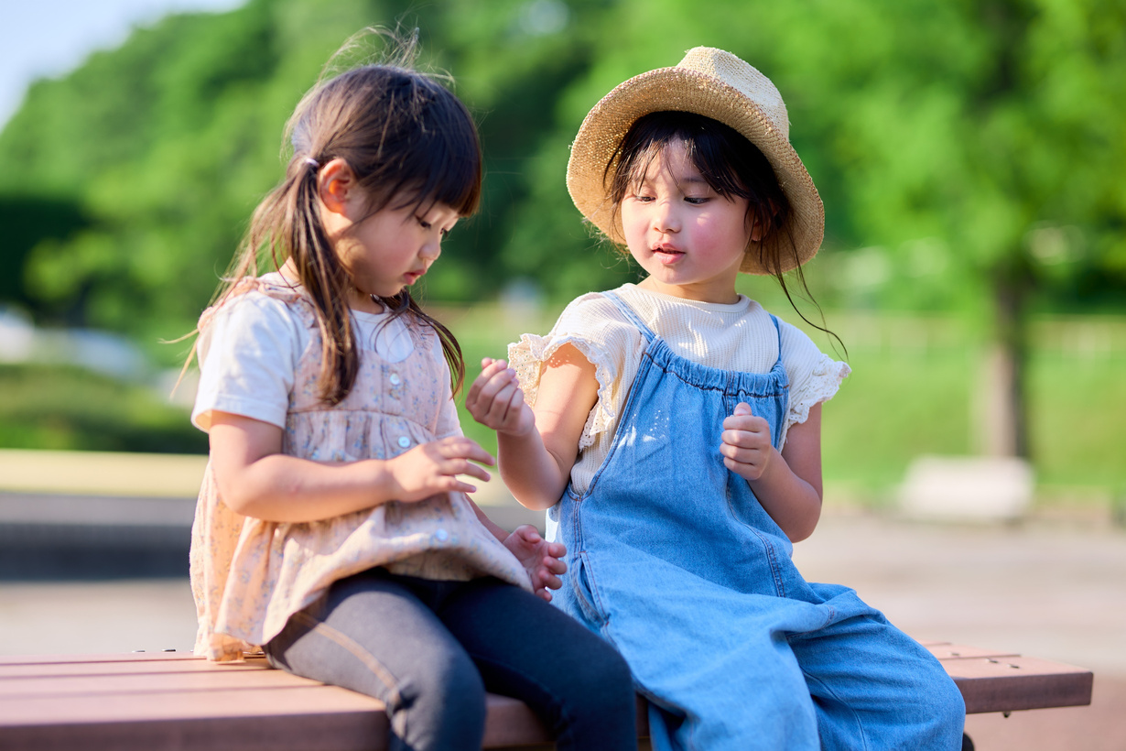
Sharing the planet
An inquiry into the interdependence of human and natural worlds through:
rights, responsibilities and dignity of all
02
pathways to just, peaceful and reimagined futures
nature, complexity, coexistence and wisdom

